Slide 1
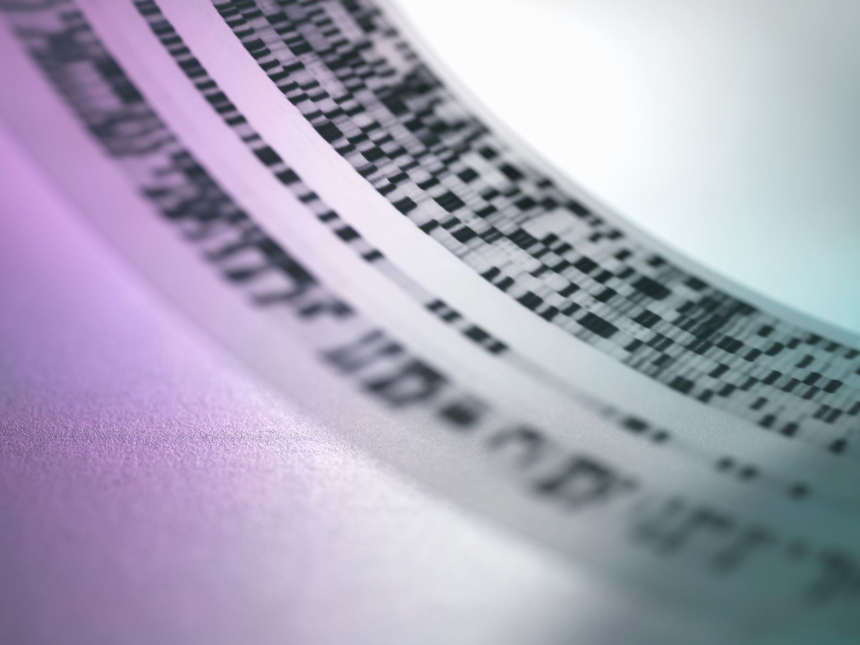

Rapid Microbe Identification
A Machine Learning proof-of-concept

Slide 2
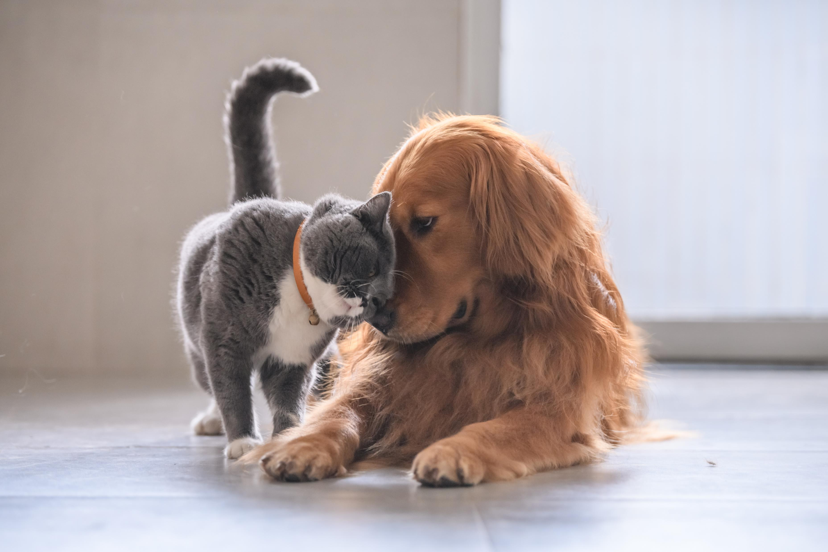
People love pets
We don’t want our furry friends to be sick
An average American spends $687 per year on their cat and over $1,200 on their dog
Primary costs are food, followed by veterinary care

Slide 3
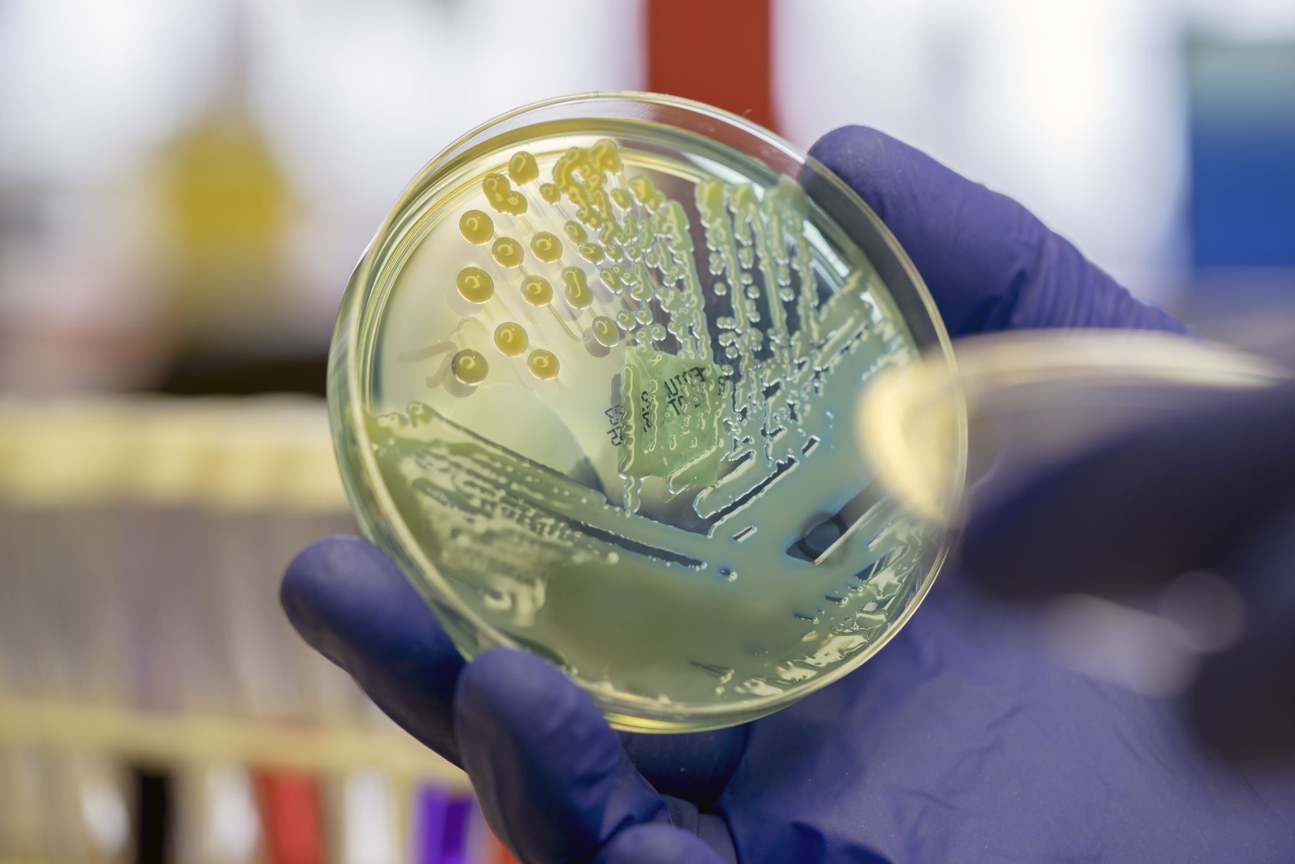
Speed of Identification
Microorganisms can replicate very quickly
Identification takes time
Manual identification is subjective
Identification drives treatment
Notes:
Short doubling times, some measured in minutes; time is an important factor with microbial infections
Culturing bacteria for ID methods takes time and so do genetic testing methods
Technicians can look at organisms under a microscope and maybe get a broad reading of the microbe type; subjective and variable
ID is used to determine precise treatment options; without ID, broad spectrum antibiotics are used, leading to antibiotic resistance

Slide 4
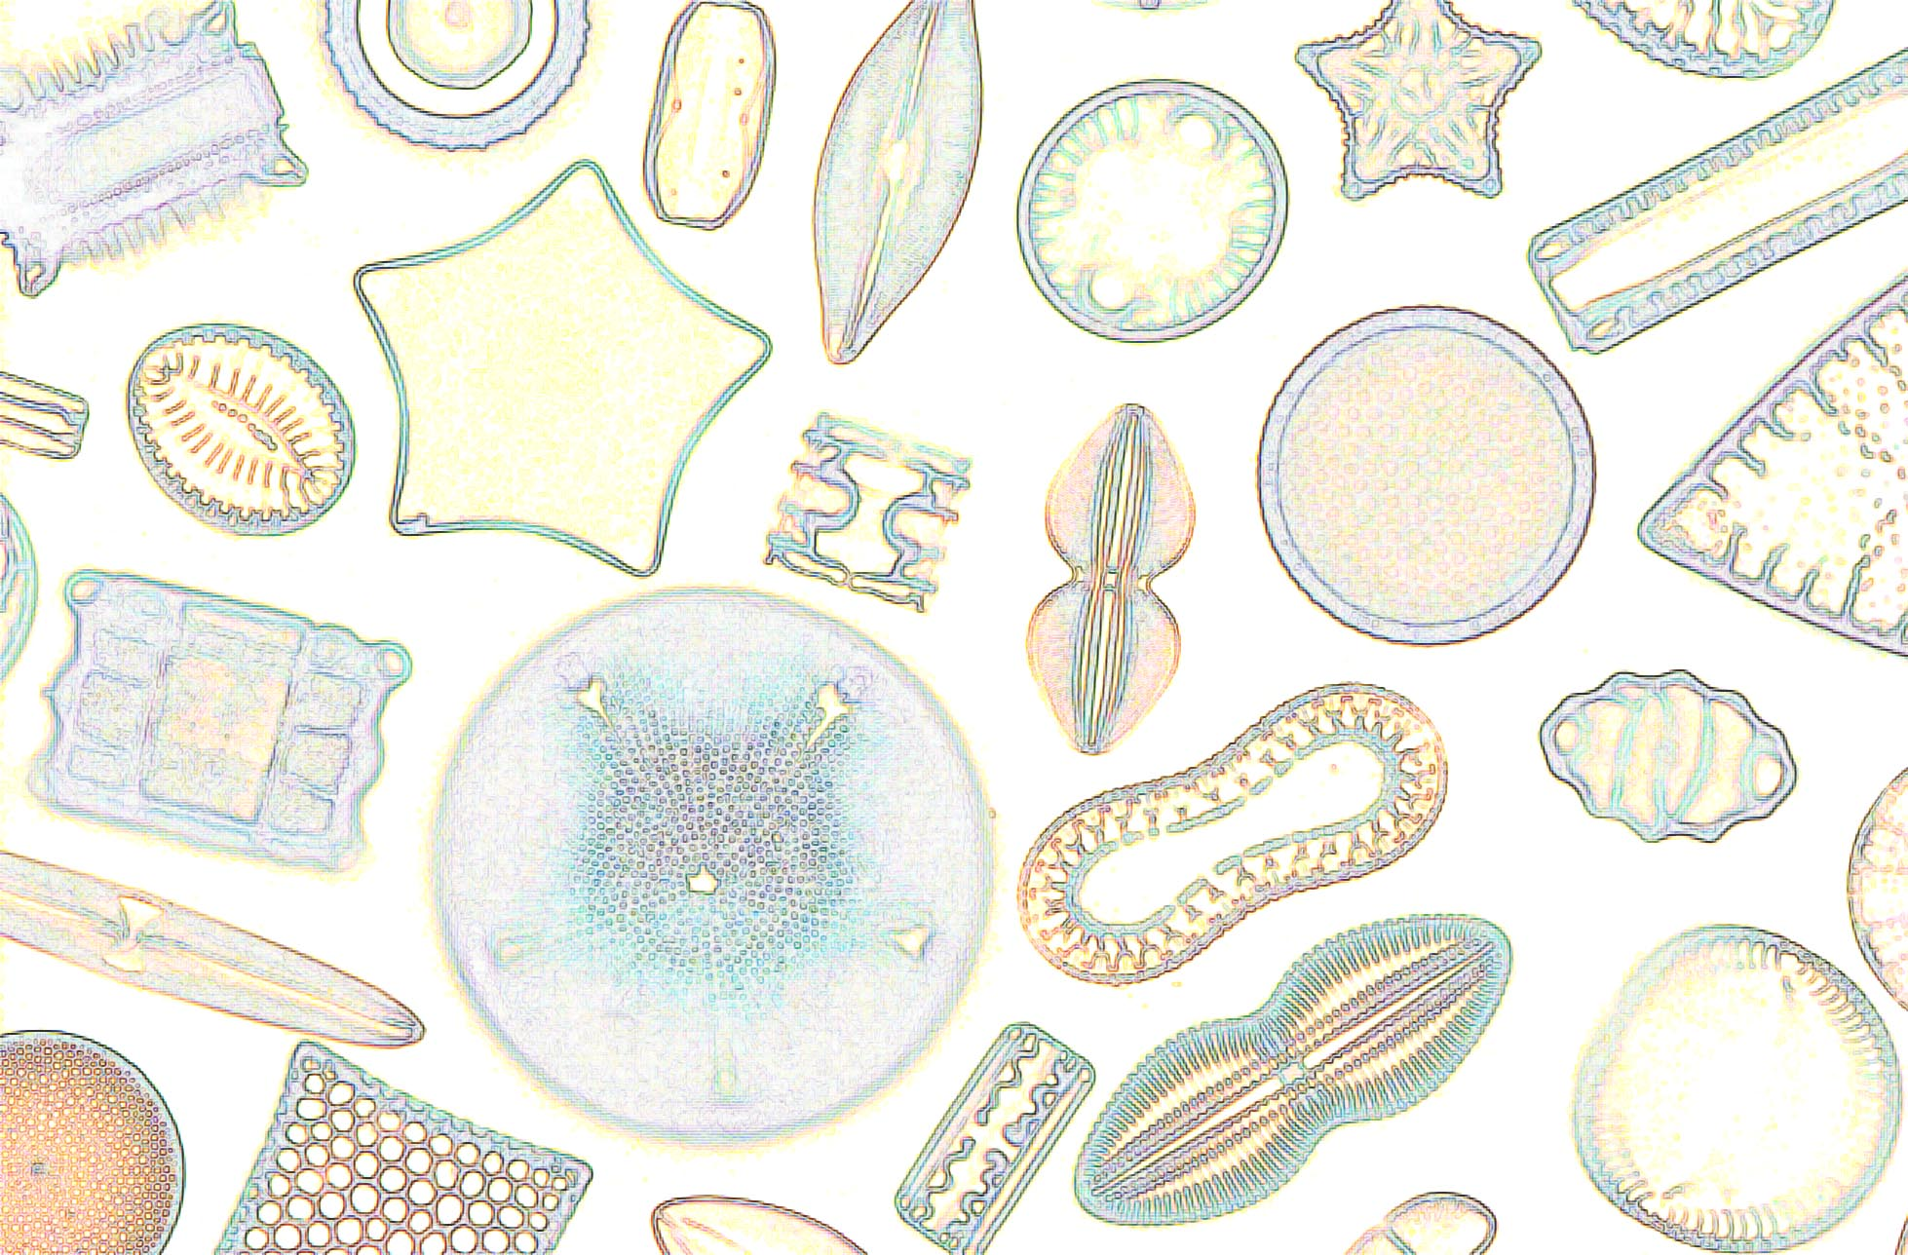
Microbes Dataset (Kaggle)
23 numeric features
Measurements generated from microscopic imagery
Many skewed distributions
Target: names of organisms
10 classes
Imbalanced
Are the samples representative?
Optimal number of features
https://upload.wikimedia.org/wikipedia/commons/f/f1/Diatoms.jpg
Notes:
Measurements automatic; many similar / correlated, how selected? Better choices (NN)?; skew; optimal features? All
Target variable: 10 microorganisms; imbalance (25% / 2%); class_weight=‘balanced’ (modest improvement); sampled/resampled to average number – lowered metrics for all, but using 25% less data;
Representative of real-world? Of their class (species)?; diatoms are quite varied

Slide 5

Comparing algorithms
Best algorithms:
RandomForestClassifier - 98.2%
DecisionTreeClassifier - 98.0%
GradientBoostingClassifier - 87.5%
Worst algorithms:
GaussianNB (Naïve Bayes) - 33.0%
AdaBoostClassifier - 30.2%
After tuning:
RandomForestClassifier - 98.7%
DecisionTreeClassifier - 98.7%
Notes:
Metrics considered: Accuracy, F1-Score, Precision, Recall; all were comparable to Accuracy; hyperparameter tuning using GridSearchCV

Slide 6
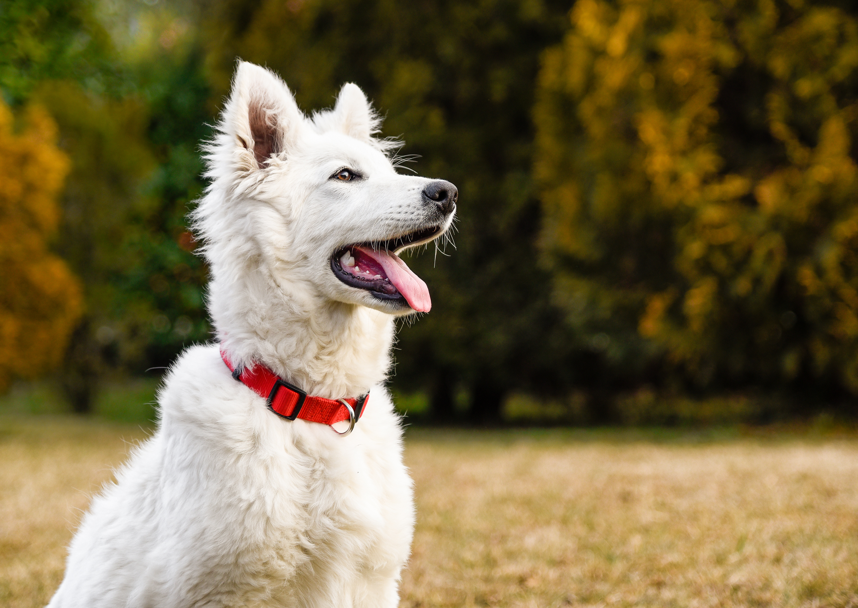
Conclusion and next steps
Selected model:
Decision Tree Classifier
Recommendations:
Supplement data set
Expand to additional microbes
Consider new measurements
Train a neural network directly on microscope images
Notes:
Given the comparable results between RFC and DTC, proceed w/DT because easier to interpret (troubleshooting & further analysis/improvement) and ~10x faster
Generate more data; expand to more microbe taxons and try different genera or species within a taxonomy; look for other useful measurements
Allow NN to directly extract features useful for classification

